Slide 1
Life’s a Game and the Game of Life: How Making a Game out of it Can Change Student Behavior
Adrienne Decker & Elizabeth Lane Lawley
School of Interactive Games & Media
B. Thomas Golisano College of Computing & Information Sciences
Rochester Institute of Technology
adrienne@mail.rit.edu | ell@mail.rit.edu

Slide 2
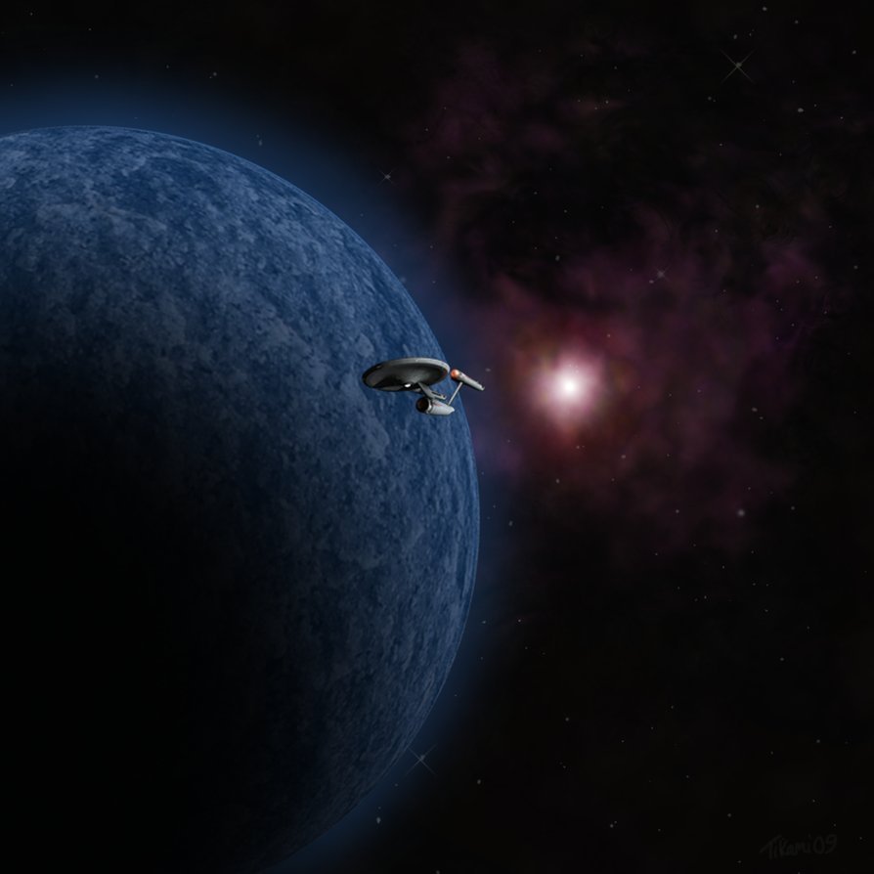
Space – the Final Frontier
http://tikamihasmoved.deviantart.com/art/Space-The-Final-Frontier-145023577

Slide 3
CS1/CS2 – the Final Frontier
http://tikamihasmoved.deviantart.com/art/Space-The-Final-Frontier-145023577

Slide 4
The Final Frontier
Quick sort
inheritance
parameters
objects
functions
variables
If I could just get them to learn
they would be successful.
binary search trees

Slide 5
REALLY ?!?!?!

Slide 6
The Truth is Out There…
Actually, I think we all know there is more to student success than learning
Quick sort
objects
binary search trees
parameters
functions
variables
inheritance

Slide 7
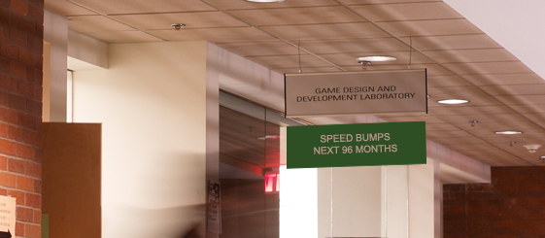
The Realization
Students arrive with a general sense of where they are going
Uncertainty for the next 4-5 years of their lives
Not always aware of the critical behaviors and decisions that define success and failure

Slide 8
The Big Questions!
What does it mean to “win” at college?
What are the steps to “win” at college?
What does it mean to “win” at life?

Slide 9
The Big Questions!
Can we help the students on their journey to the “win”?
Does our version of success == student version of success?

Slide 10
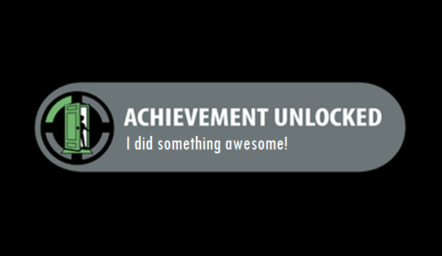
A More Profound Question
Student asks:
“Why can’t we get achievements for being awesome?”

Slide 11

Thus was Born

Slide 12
What is Gamification?
From Gamification Wiki (http://gamification.org)
  “…the infusion of game design techniques, game mechanics, and/or game style into anything”

Slide 13
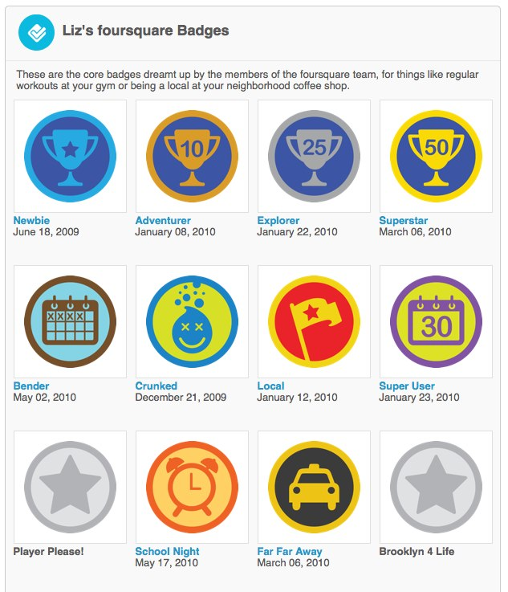
Tools of the trade
When people think gamification, they think
  Achievements
  Quests
  Trophies
  Currencies
  Progress Bars
  Levels and Powerups

Slide 14
Gamification - an 8 letter word
Pitfalls
Potential
Purely a business gimmick
Low hanging fruit that tugs at the cultural identity around youth through popular culture
Easy entry into the power of interactive experience and social media
Fluff – gratification in meaningless way
Potential damage – external rewards may actually damage our intrinsic motivations
Voluntary, Fun, and Engaging
Creator as well as Consumer
Ability for reflection – where did I come from?
Celebrating the experience over the reward

Slide 15
Gamification – Will it Float?
Easy to be lured by “the Dark Side”
  Must avoid cliché and meaningless achievements
  Must not make it about the everyday
  Must not make as a veneer for repetitive, difficult work
  Must not make artificial, contrived
  Must not remove player autonomy

Slide 16
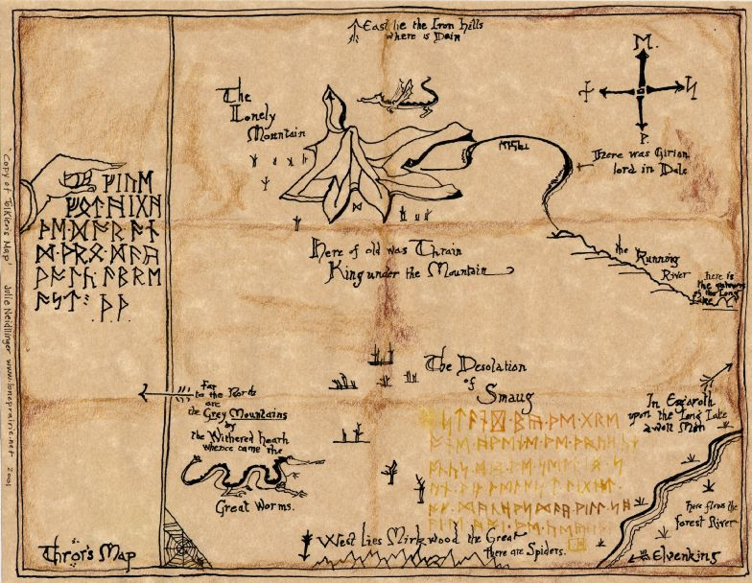
The Quest
It is really the concept of the hero’s quest
Not just knowing “here be dragons!”, but embracing the challenges ahead
Creation of the narrative and reflecting on the journey are keys to success!

Slide 17
The Big Questions
What behaviors do we want to reward and encourage?
What feelings of competence can we engender?
What do we want our players to remember and reflect upon?

Slide 18

The Story
The Athenaeum vs. Mechanics Institute

Slide 19
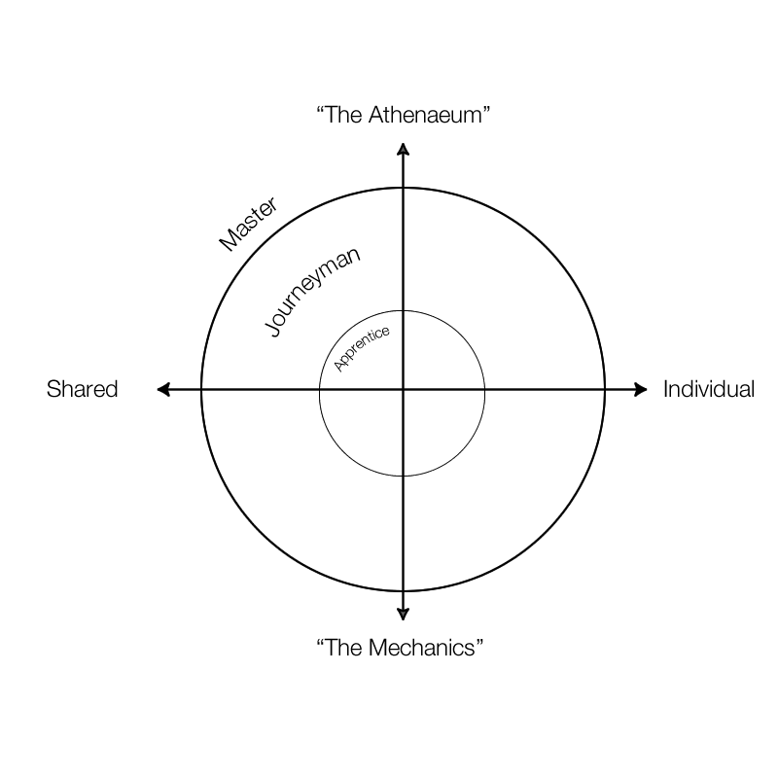
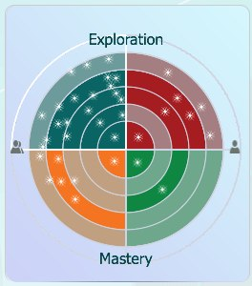
JPP Motivations

Slide 20
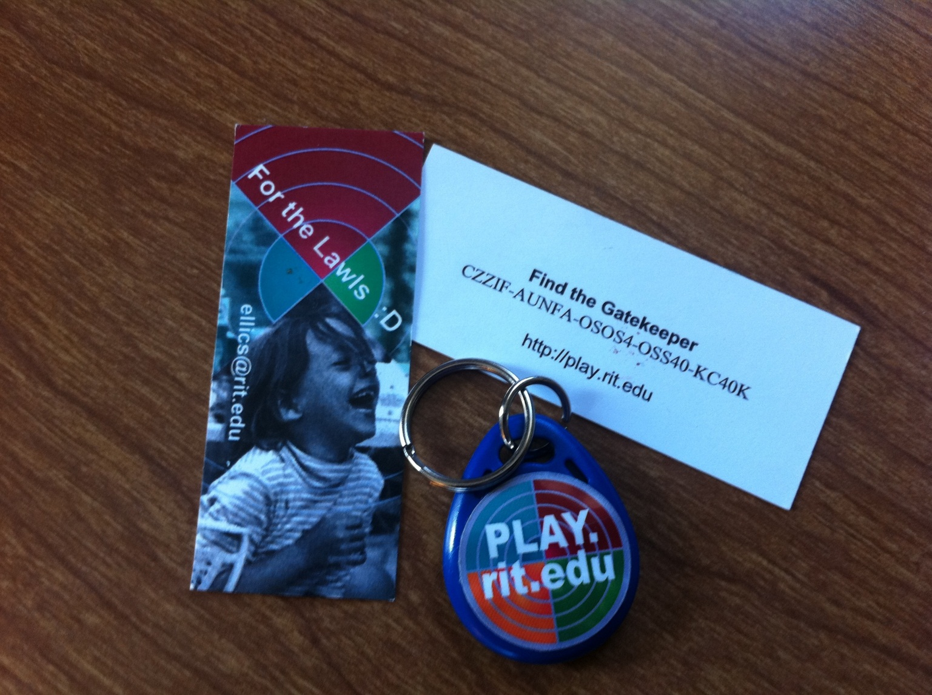
Tangible Elements

Slide 21
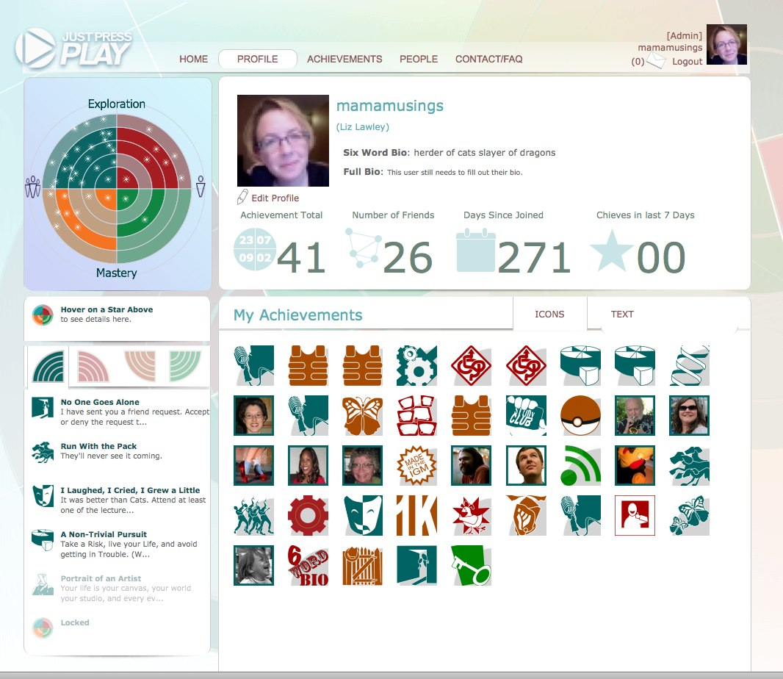
Profile

Slide 22
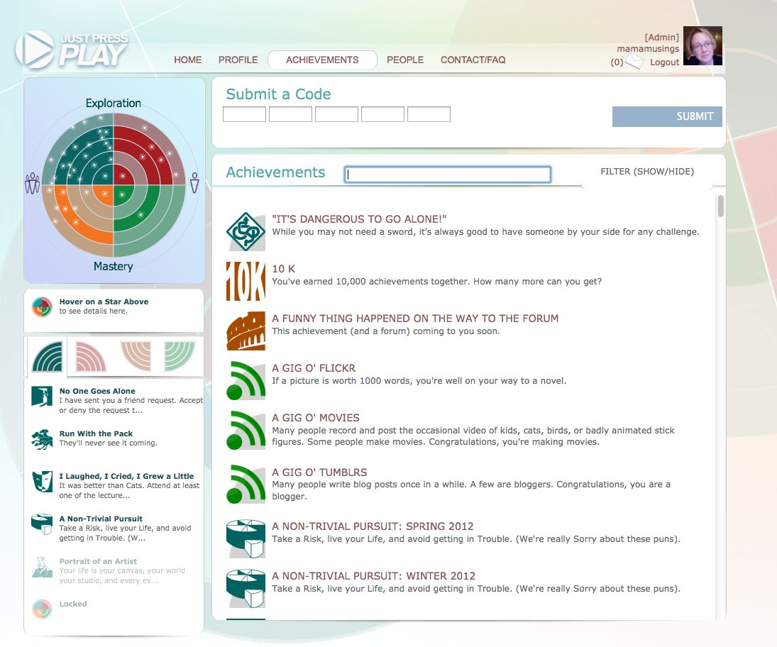
Uncompleted Achievements

Slide 23
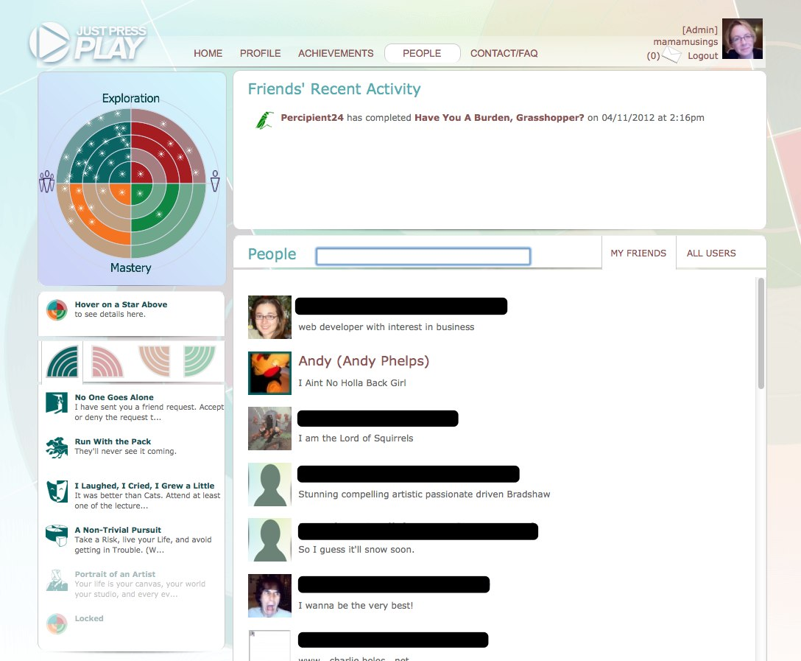
People

Slide 24
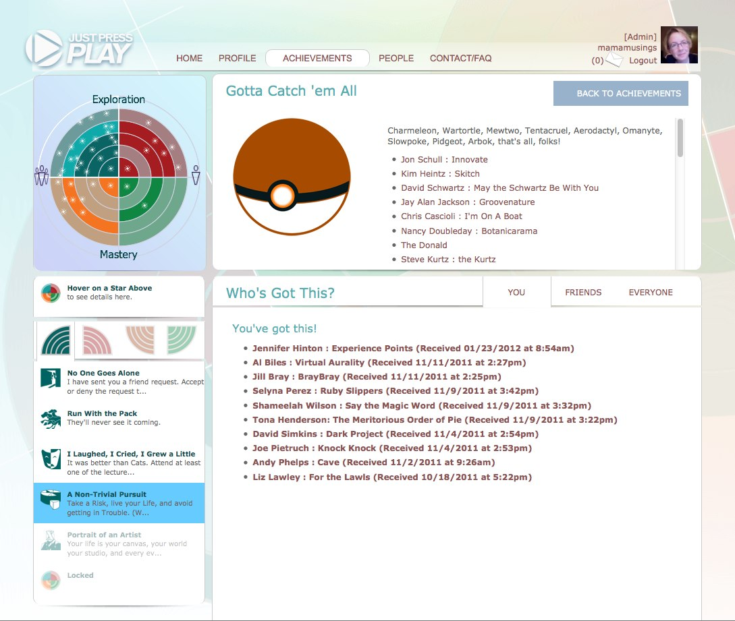
Quests

Slide 25
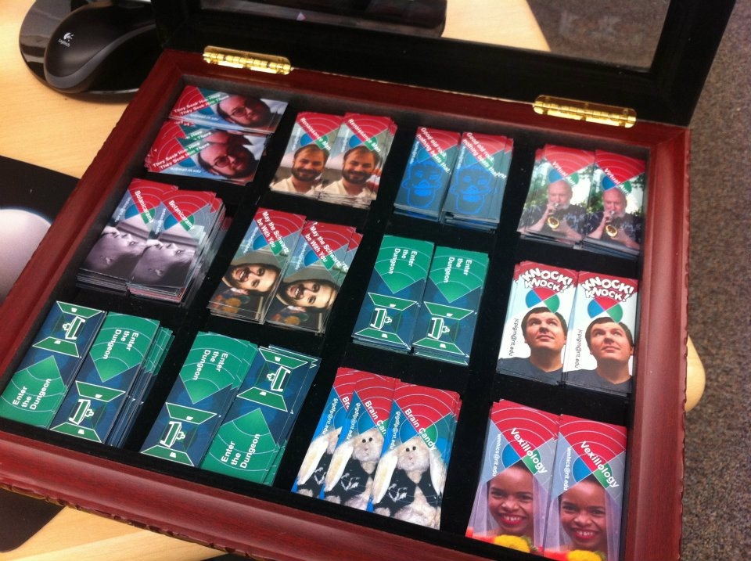
Achievement Types

Slide 26
Achievement Types
Ideation
Exploration
Communication
Cultural Enrichment
Socialization
Team building
Tools for success
Connecting
Iteration/Refinement
Engagement
Confidence
Fun
Whimsical

Slide 27
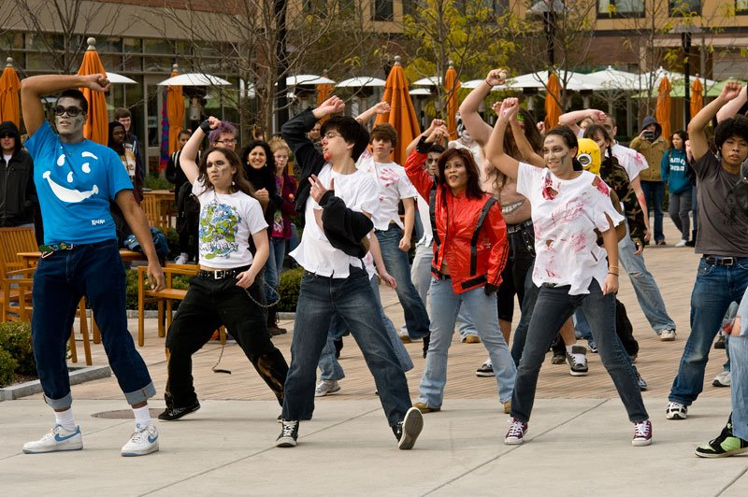
Achievement Types

Slide 28
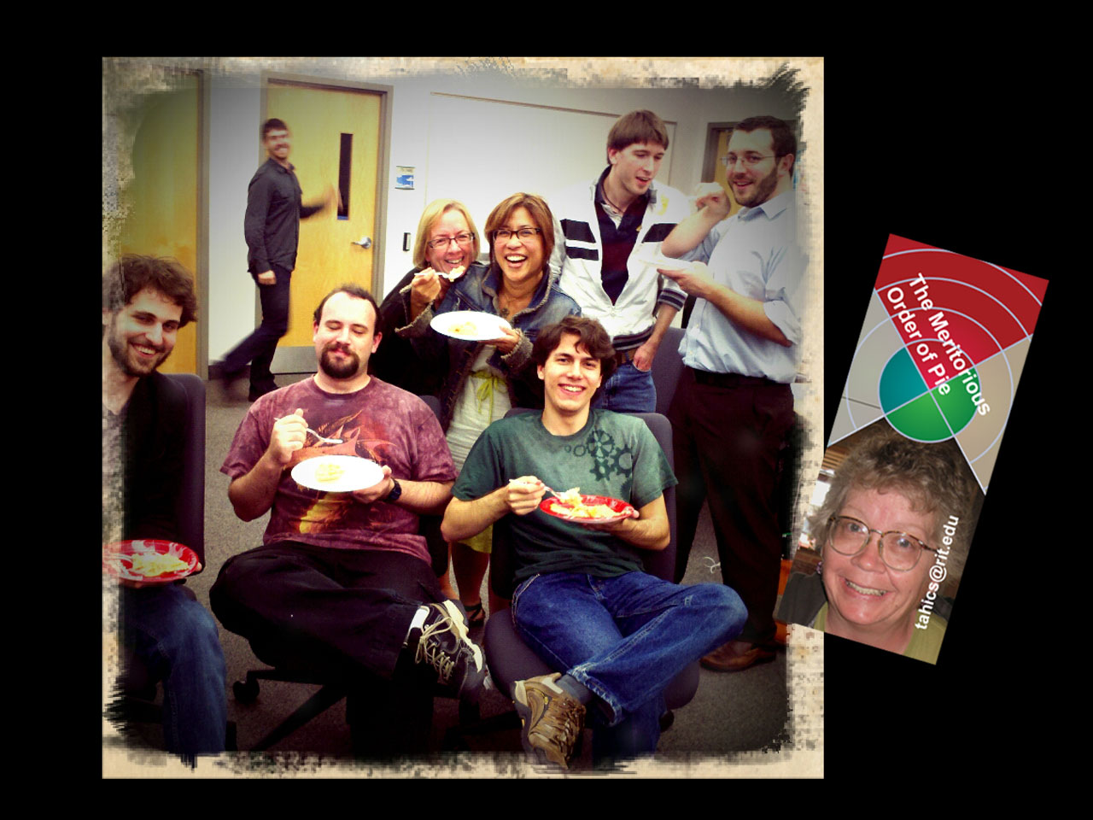
Achievement Types

Slide 29
Prepare to Launch
Pilot launched October 2011
  Day 1: 155 registered players
  Week 1: 384 registered players
  Year 1: 423 registered players

Slide 30
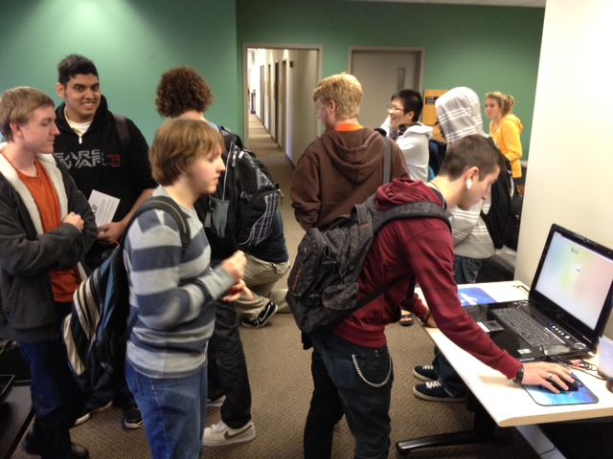
By the Numbers
Over 60% of all students in the School (department) registered for the game, and nearly 40% of the registered players have completed the tutorial level .
Higher percentage of freshmen and sophomores than juniors and seniors.

Slide 31
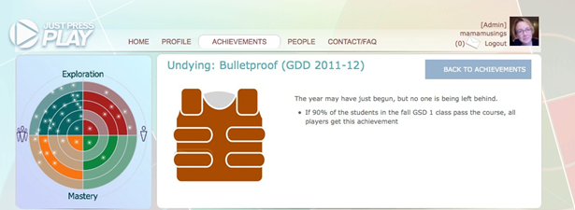
The mission, should you choose to accept it...

Slide 32
The Student Response
Hi Prof. XXX,
YYY (cc'd on this email) and I are arranging a study session for people in GSD I the weekend before finals. We were wondering if we could meet with you at some point this week or next to get an idea of what you have covered in your class this quarter, and what you are expecting your students to know for your final. If you could let us know when you are free to meet, that would be great.
Thanks.
ZZZ
3rd Year Game Design & Development Major

Slide 33
The Faculty Response

Slide 34
The Results
Review Sessions were scheduled and held for the first year students right before finals.
Percent that passed first course:
91%

Slide 35
Great – so what – Big Deal - we’ve heard this before….
What happens next year, or the year after…

Slide 36
Winter Quarter
Same challenge issued for second course for first years.
Same upperclassmen (and others who had heard about it) held session for MIDTERMS and finals.
We win again (over 90% of students passed the second course).

Slide 37
Spring Quarter
Pilot of JPP concluded at end of winter quarter.
Sessions were still held for first years for the third quarter classes.

Slide 38
Just Press Play – Version 2
“Once more with feeling…”

Slide 39
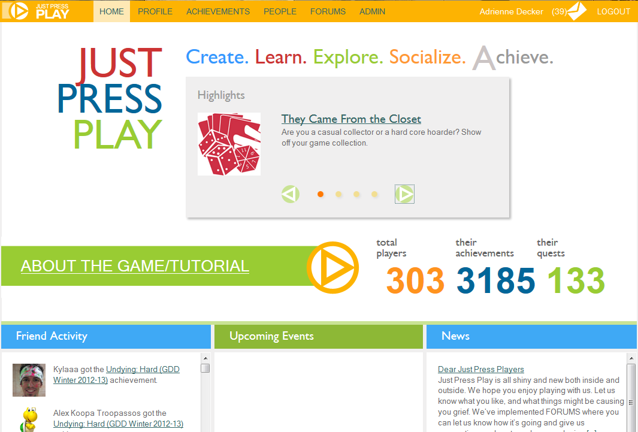
Version 2 – Fall 2012

Slide 40
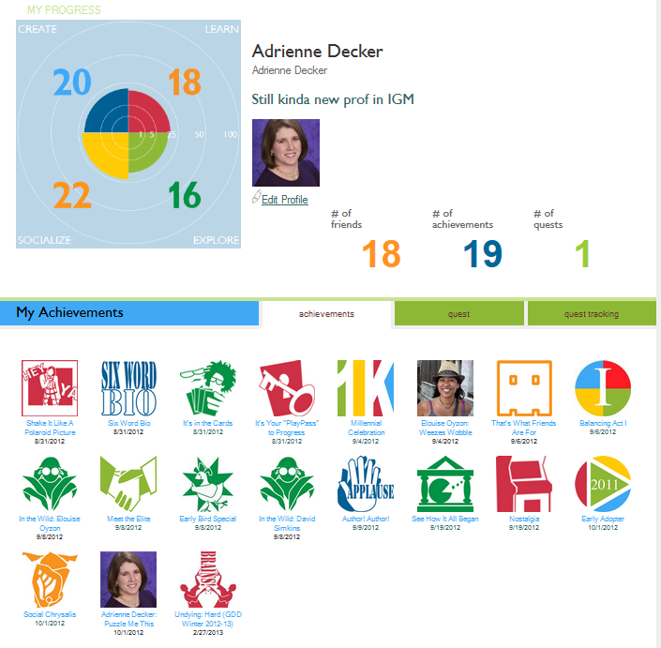

Slide 41
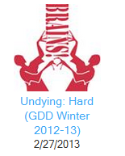
Did it again!

Slide 42
Questions?
More info:
play.rit.edu
http://research.microsoft.com/en-us/projects/justpressplay/

