Slide 1
Computing Outreach Literature Review
Adrienne Decker, Monica M. McGill, Amber Settle
Rochester Institute of Technology, Bradley University, DePaul University
Is there a long-term impact on participants in computing outreach activities?
ACM SIGCSE Technical Symposium on Computer Science Education (SIGCSE)
IEEE Frontiers in Education (FIE)
Innovation and Technology in Computer Science Education (ITiCSE)
International Computing Education Research Workshop (ICER)
Taylor & Francis’ Computer Science Education
ACM Transactions on Computing Education
2009-2014 inclusive

Slide 2

Examination of Articles
Outreach
K-12
Elementary school
High school
Secondary school
After school clubs
Summer camp
3672 articles
101 careful read
73 in final analysis
No evaluative component
Only 7 had longitudinal component

Slide 3
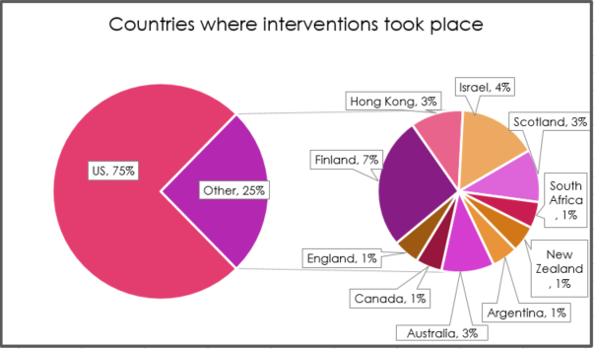
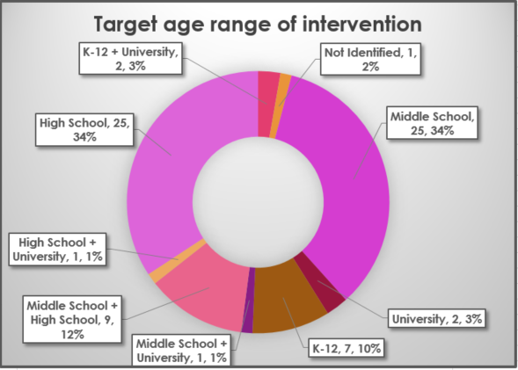
Some Results
53% of interventions were designed to increase gender diversity
34% of interventions were designed to increase ethnic diversity
Studies showed increase in positive attitude toward computing as a discipline and a course of study, self-efficacy, and increased skills in computing. Participants enjoyed activities.

Slide 4
Some Problems
1% - Unable to identify if study was quantitative, qualitative, or mixed methods
10% - Unclear if the study was designed to increase gender diversity
6% - Unclear if the study was designed to increase ethnic diversity
22% - No indication of number of participants in interventions
30% - No indication of gender of participants
63% - No indication of ethnicity of participants

