Slide 1
Uncovering Difficulties in Learning for the Intermediate Programmer
Adrienne Decker, David Simkins
School of Interactive Games and Media and RIT Center for Media, Arts, Games, Interaction and Creativity (MAGIC)
Rochester Institute of Technology
adrienne.decker@rit.edu, dwsigm@rit.edu

Slide 2
Computing Education Research
CS1 & CS2
Advanced Placement
Capstones, Software Engineering Projects
Undergraduate

Slide 3
First Day Survey
Summer course named Data Structures
Typically taken after courses that roughly cover CS1 and some of CS2, discrete math course, taken after or concurrently with a digital logic/circuits course
Ten 5-point Likert-type questions
  Thinking back to your previous computer science courses, for each of the topics listed, indicate how easy/difficult you felt it was to learn.
Three free response/short answer questions
  Give an example of something you studied in your previous computer science courses (does not have to be from the list above) that you feel you still don't understand very well.

Slide 4
Topics Covered by Data Structures
  linked lists, stacks, and queues
  Algorithm analysis (Big O, etc.)
  time and space complexity
  induction and recursion
  loop invariants and program correctness
  sorting
  binary search trees
  tree rotation and B-trees
  priority queues and heaps
  hashing
  graphs
  counting

Slide 5
Some Results
Topic | Perceived by students to be more difficult than
Writing programs in Java Writing classes Writing a program that has lists of data | Using variables
Writing programs in Racket | Writing programs in Java Writing Functions
Polymorphism | Using variables Writing functions

Slide 6
Some Results
Topic | Perceived by students to be more difficult than
Writing recursive function | Using variables Writing functions Writing classes
Creating a DFA that solves a given problem | Using variables Writing functions Writing classes
Writing Proofs | Writing progams in Racket Writing programs in Java Using variables Writing functions Writing recursive functions Creating a DFA that solves a … Polymorphism Writing classes …program that has lists of data

Slide 7
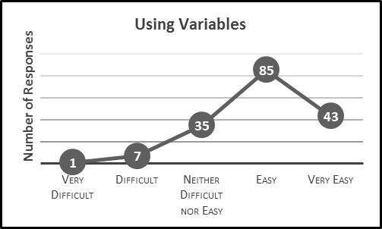

Slide 8
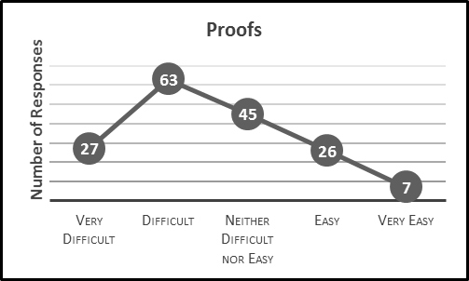

Slide 9
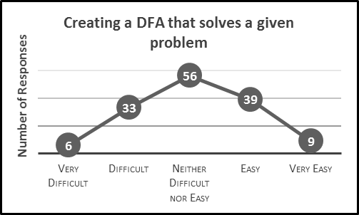

Slide 10
Give an example of something you studied in your previous computer science courses (does not have to be from the list above) that you feel you still don't understand very well
N = 151
96 unique responses
  68 of which were not repeats of the original ten prompts or responses we categorized as “one-offs”
Proofs/induction (18%), Circuits (5%), Pointers (5%)
80 of the 96 responses (83%) had a frequency of 3 or less (1% or less)

Slide 11
Conclusions and Future Work
The results from the data analysis largely confirm previous studies about what topics students find difficult.
Analysis of other two free response questions
More work to be done to understand what is going on with this group’s learning

