Slide 1
Learning Loops:
A Replication Study Illuminates the Impact of HS Courses
Briana B. Morrison
Adrienne Decker
Lauren E. Margulieux

Slide 2
In the nascent field of computer science education, we have become particularly good at two things:
Publishing new studies; and
Establishing that our students don’t know what we think they should know

Slide 3
Outline
Original Study
Original Results
This Study
Results
Extension
Findings
Contributions

Slide 4
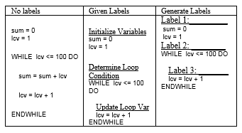
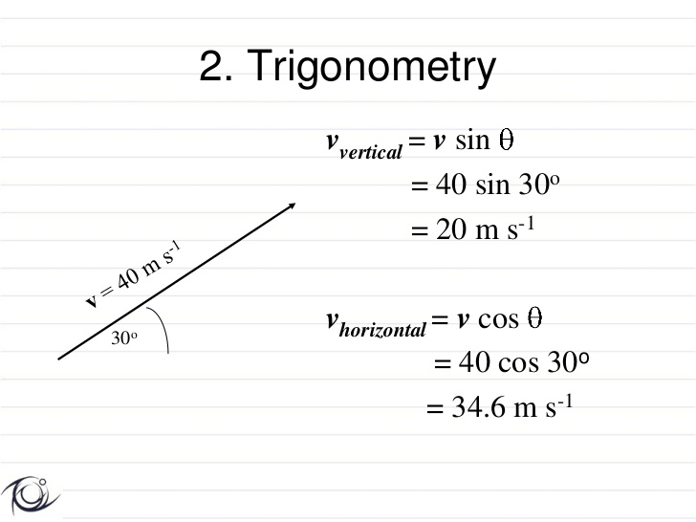
Ed Psych Refresher
Working Memory
Cognitive Load
Worked Examples
Subgoal Labels
Extraneous
Load
Intrinsic
Load
Germane Resources
Extraneous Resources
Notes:
Cognitive Load Theory – eliminate the extraneous load while minimizing the intrinsic load to keep the total amount of processing requirements within the limited capacity of working memory
Worked Examples – instructional device that provides an expert’s problem solution for a learner to study.
Subgoal Labels - function-based instructional explanations that describe the purpose of a subgoal to the learner, demonstrating the solution process.

Slide 5
Original Study
Purpose
Participants
Material
Design
Procedure
Age | Gender | GPA | Major
M = 21 | 89% male | M = 3.1/4 | 50% CS major
Notes:
Purpose: to teach students how to write a while loop
3 classes – java, C++ (engineers), and C# (gaming majors)
Pre-test scores low (24%) with 32% (21 students) earning no points (5 questions from AP CS tests)
Analyzed 66 of 96 students – lab credit;
Excluded those who did not attempt all tasks, and those with 3+ right on pre-test

Slide 6
Material
Subgoal Generate group (C)
You have been told that a pair of dice roll the number 7 more than any other combination. You would like to find out if that’s true. To do this you have a pair of dice that you’ve rolled 20 times. You need to count how many times 7 was rolled.
Here are all the rolls of the dice. How many times was 7 rolled?
2, 8, 7, 6, 4, 7, 9, 11, 8, 6, 7, 4, 3, 5, 7, 11, 9, 7, 4, 12
Solution
SUBGOAL:
Step one: define and initialize variable to hold the collection of dice rolls
rolls = [2, 8, 7, 6, 4, 7, 9, 11, 8, 6, 7, 4, 3, 5, 7, 11, 9, 7, 4, 12] list containing all the dice rolls
Step two: define and initialize variable to hold the count of 7 rolls
rolls = [2, 8, 7, 6, 4, 7, 9, 11, 8, 6, 7, 4, 3, 5, 7, 11, 9, 7, 4, 12] list containing all the dice rolls
count = 0 variable to hold the count of times 7 was rolled
SUBGOAL:
Step three: initialize the loop to start at the beginning of the list of dice rolls
rolls = [2, 8, 7, 6, 4, 7, 9, 11, 8, 6, 7, 4, 3, 5, 7, 11, 9, 7, 4, 12]
count = 0
lcv = 0 lcv is loop control variable
# We want to start by looking at the first value in the list which has an index of 0
Notes:
Explain steps vs. subgoals
Steps – expert solution to the problem in step by step fashion, problem specific
Subgoal – can be many steps, structure carries over between problems

Slide 7
Material
SUBGOAL:
Step seven: determine if the current dice roll is a 7
rolls = [2, 8, 7, 6, 4, 7, 9, 11, 8, 6, 7, 4, 3, 5, 7, 11, 9, 7, 4, 12]
count = 0
lcv = 0
WHILE lcv < length(rolls) DO
IF rolls[lcv] == 7 THEN if the current roll is equal to 7
ENDIF
lcv = lcv + 1
ENDWHILE
Step eight: if the roll is 7, increment the count
rolls = [2, 8, 7, 6, 4, 7, 9, 11, 8, 6, 7, 4, 3, 5, 7, 11, 9, 7, 4, 12]
count = 0
lcv = 0
WHILE lcv < length(rolls) DO
IF rolls[lcv] == 7 THEN if the current roll is equal to 7
count = count + 1 increment count by one
ENDIF
lcv = lcv + 1
ENDWHILE

Slide 8
Original Study Design & Procedure
Subgoal Labels
None
Given
Generated
Analogy
Analogy
Subgoal
Isomorphic
WE no labels
WE with labels
WE space for labels
Isomorphic
Isomorphic PP
Isomorphic PP
Transfer
PP
practice
Analogy
Analogy
Subgoal
problems
Contextual
WE no labels
WE with labels
WE space for labels
transfer
Contextual
Contextual
Contextual transfer
transfer PP
transfer PP
PP
Notes:
Consent, demographics, pre-test, training activity (intro to loops)
Analogy training or subgoal training (keep time on task similar)
3 sets of worked example, problem solving pairs
Problem solving assessment – 2 near transfer, 2 far transfer
Assessment 3 – parsons problem
Post test

Slide 9
Results (agree with previous findings)
Interaction** (p = 0.003)
Notes:
Previous findings in math and science (none in CS)
No main effect of worked example format or transfer
generate group interaction not SS but medium effect size (p= 0.077, d=0.78)
Results on post test similar – scores low (31%), no SS on WE format, transfer, or interaction
Generate – Context Transfer group best on post-test while Generate-Isomorphic best on problem assessments (cognitive overload?)

Slide 10
Results (puzzling)
Interaction** in Given (p = 0.021) with large effect size (1.07)
Notes:
Given-Isomorphic did poorly on both problem solving and post-test did best on far transfer problems
Given-Context Transfer best for assessment tasks but least amount on the assessments.

Slide 11
Replication Study
Course | Programming Language | Majors | Experiment Delivery Method
101 | Processing | New Media Interactive Design, New Media Interactive Development | Closed lab in-class exercise
105 | C# | Game Design & Development | Optional at-home assignment
Notes:
3 different 1st and 2nd year programming courses at a technical university in the northeast United States
1 month period
101 - first year, first semester course; CS1 for New Media Interactive Design (artists - a College of Imaging Arts and Sciences major), or New Media Interactive Development (technologists - a College of Computing and Information Sciences major); uses Processing
105 – first year, first semester CS1 for Game Design and Development (a College of Computing and Information Sciences major) uses C#
No AP credit for 101 or 105

Slide 12
Replication Study
Course | Programming Language | Majors | Experiment Delivery Method
101 | Processing | New Media Interactive Design, New Media Interactive Development | Closed lab in-class exercise
105 | C# | Game Design & Development | Optional at-home assignment
202 | C# (some Processing) | New Media Interactive Design, Game Design and Development | Closed lab in-class exercise
Notes:
202 brings together New Media Interactive Development and Game Design and Development; primarily C# (with some limited time devoted to Processing) and focuses on the use and integration of media and media artifacts into interactive experiences
101 -> 102 -> 201 -> 202
105 -> 106 -> 202

Slide 13
Replication Participants
Age | Gender | GPA | Major
M = 19 | 72% male | M = 3.5/4 | 33% New Media 63% Game Design 3% CS, SWE, CEngr
Identical study materials, design, and process
Notes:
N = 100
Excluded those who did not attempt all tasks, and those with 3+ right on pre-test
Analyzed 27 for replication

Slide 14
Replication Results
Worked example format * transfer distance p = 0.015 ω² = 0.33 f = 0.44
Notes:
2 types of effect sizes:
ω^2 of 0.1 is 10% of variation in performance can be attributed to the instructional manipulations
f or d is difference between groups using the std deviation as the unit of measurement; d of .5 difference between the means of the two groups is half of the std deviation for those groups
In addition, Given Labels group: not statistically significant, but effect size of d = 0.95
Means that the difference between the means of the two groups is 95% of the std dev for those groups
F estimates of a population variance, based on the information in two or more random samples

Slide 15
Other Results
No statistical significance for worked example, transfer distance, or interaction for:
Parsons problem accuracy results
Time completing worked examples / practice problems
Time on code writing assessments
Time of Parsons problem assessment

Slide 16
What About Those Other Students?
Excluded 24 students from intro courses who scored 3 or better on pre-test
Did they have previous CS coursework?
Notes:
Almost as many as we analyzed (27)

Slide 17
Problem Solving – All Intro Students
Notes:
Interaction - p = 0.024 ω² = 0.15
Pre test = average 46% (2.31/5)
Post test = Average 54% (2.72 out of 5 points)

Slide 18
202 Students – Problem Solving
**Given performed better than others: p = 0.002 ω² = 0.25 f = 0.37
Notes:
N = 49
Pre test = 73% (3.6 out of 5)
Post test = 70% (3.5 out of 5)
Given performed better than others: p = 0.002 ω² = 0.25 f = 0.37
25% of variation in performance can be attributed to the instructional manipulations
Means that the difference between the means of the two groups is 37% of the std dev for those groups

Slide 19
202 Students – Parsons Problem
Notes:
Generated performed worse! than others: p = 0.014 ω² = 0.18 f = 0.31
Example of reverse expertise effect?

Slide 20
Effect of Previous Coursework – Code Writing
Those w/ HS course better on code writing: p = 0.001 ω² = 0.11 f = 0.35
Those w/ college course performed better: p < 0.001 ω² = 0.13 f = 0.38
Notes:
Those w/ HS course better on code writing: p = 0.001 ω² = 0.11 f = 0.35
Those w/ college course performed better: p < 0.001 ω² = 0.13 f = 0.38
Interaction: p = 0.001 ω² = 0.10 f = 0.33
It does not matter if previous course was taking in high school or college – the fact that the student had a previous course predicts better performance but that advantage does not continue into the next course – THEY CATCH UP!
Those w/HS course better on Parsons: p = 0.002 ω² = 0.09 f = 0.31
Those w/ college course performed better: p = 0.011 ω² = 0.07 f = 0.26
No Interaction: those with computing courses in high school performed better than those who did not, even after first college computing course. Longer time to learn or reverse expertise?

Slide 21
Effect of Previous Coursework – Parsons Problem
Notes:
Those w/HS course better on Parsons: p = 0.002 ω² = 0.09 f = 0.31
Those w/ college course performed better: p = 0.011 ω² = 0.07 f = 0.26
No Interaction: those with computing courses in high school performed better than those who did not, even after first college computing course. Longer time to learn or reverse expertise?

Slide 22
Contributions
Replication of surprising results
  Students creating explanations need sufficient instructional support to succeed
  Interaction warrants further investigation
Previous Coursework
  They do learn, but it takes time to master
  Separate students based on prior experience?

Slide 23
Acknowledgments
NSF grant 1138378
Students who participated in studies
Referees whose comments enhanced the final version of the paper
bbmorrison@unomaha.edu

Slide 24
Discussion Time

Slide 25
Problem Solving Performance
Notes:
27 novice students in bar chart form
Error bars represent 95% confidence interval

