Slide 1

Does Outreach Impact Choices of Major for
Underrepresented Undergraduate Students?
Adrienne Decker
Rochester Institute of Technology
Monica M. McGill
Bradley University
Amber Settle
DePaul University

Slide 2
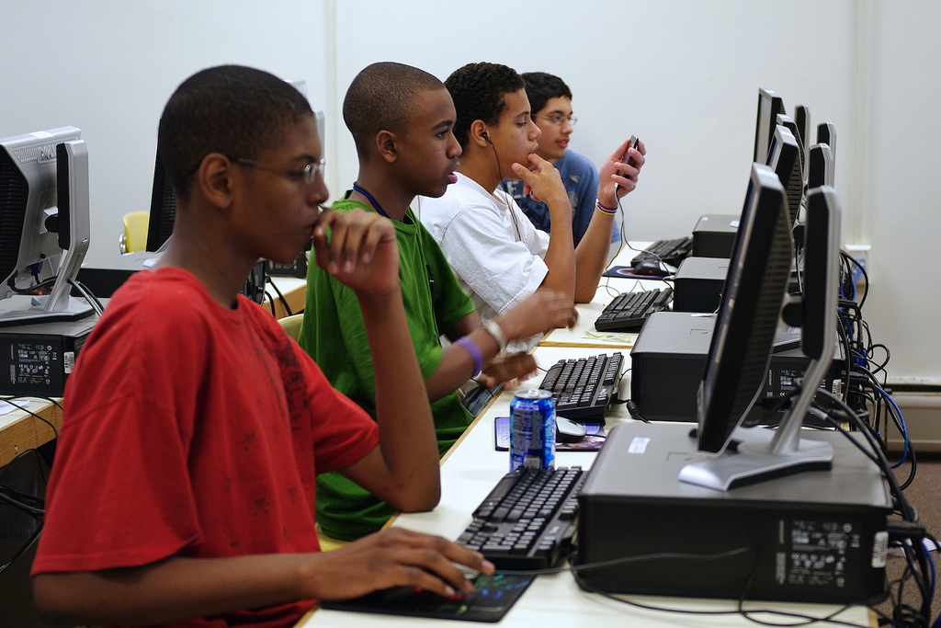
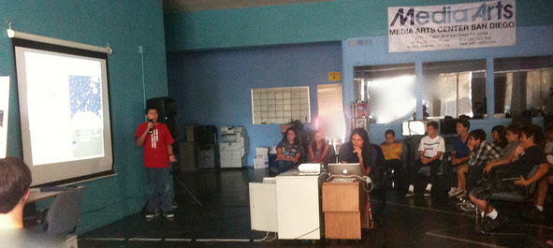
Diversity

Slide 3
Systematic Literature Review: Steps 1-3
1: Frame the question
  Is there a long-term impact on under-represented minorities who have participated in computing outreach activities?
2: Identify relevant work
  SIGCSE Conference, Computer Science Education, FIE, ITiCSE, ICER, ToCE
  2009 to 2014 inclusive.
  3,672 citations found
3: Assess quality of studies
  Keywords: outreach, K-12, elementary school, high school, secondary school, after school clubs, summer camp
  3,571 citations were excluded as irrelevant, leaving 101 articles.
5-step framework defined by
Khan, Kunz, Kleijnen, and Antes (2003)
Notes:
Framework by Khan, Kunz, Kleijnen, and Antes (2003)

Slide 4
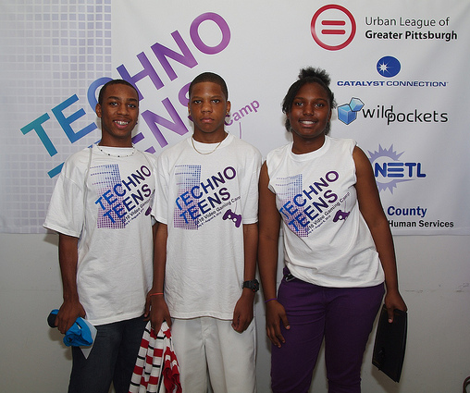
4: Summarizing the Evidence
Data Capture
  Targeted demographics of outreach
  Country in which participants lived
  Whether or not intervention was designed to increase gender and/or ethnic diversity
  Whether participant data was collected
  Whether study was quantitative or qualitative
  Number of participants
  Gender/ethnicity of participants
  What variables were assessed
  Whether there was a longitudinal component to the study
  If longitudinal, number of years
  If longitudinal, summary of findings
28 more articles removed at this stage, leaving 73 articles

Slide 5
4: Summarizing the Evidence
75% were interventions in the U.S.
82% were outreach efforts aimed at high school and/or middle school students
Designed to increase ethnic diversity?
  34% - Yes
  56% - No
  10% - Did not provide enough evidence to categorize
Participant ethnicity
  Reported by 27 (37%) of the articles
  Reported by 18 of 25 interventions designed to increase ethnic diversity (72% of that group)
Only seven (9.5%) were longitudinal studies.
  Of these seven, four articles discussed interventions designed to increase ethnic diversity.
  Two articles with K-12 participants (Georgia Computes! 2006-2012, Berkeley Foundation for Opportunities in Information Technology (BFOIT))
  Two articles with undergraduate student participants

Slide 6
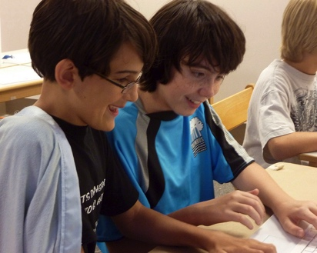
5: Interpret the findings
Considered the evidence with respect to our free-form question
Four studies presented evidence of longer-term impact, only two at the K-12 level
However, none fully answered the question about the long-term impact on the participants
More systematic study of the long-term effects of outreach programs is needed

Slide 7
Methodology
Do undergraduate students believe that their participation in computing activities prior to college contributed to their decision to major in a computing field?
Quantitative methodology (descriptive design approach)
Created survey to gather data
  Basic demographic data, including current major
  Recall the activities in general, thoughts, and feelings about their participation
Notes:
So, based on this information, we created a research question that we set out to study.
“Do undergraduate students believe that their participation in computing activities prior to college contributed to their decision to major in a computing field? “
We created a general survey to capture quantitative data. We collected basic demographic data as well as the participant’s basic thoughts and feelings about their participation in outreach activities.

Slide 8
Methodology
Validity/Recall bias
  Asked respondents to retake survey (2-4 weeks later)
  Integrated recall prompts (aided recall)
Recruitment (Email)
  Bradley University, DePaul University, and Rochester Institute of Technology
  Peer universities of diverse geography, size, institution type
    University of California Santa Cruz, Ball State University, and University of Buffalo
  findparticipants.com
  Incentive – entry for drawing - $50 Amazon certificate for each survey
Notes:
These are a few of the particulars of the study. We followed a test-retest protocol, and we also integrated recall prompts to aid the respondents in recalling past experiences.
At many of the institutions, the recruitment emails went out to all students, not just computing majors.
We recruited from across our own institutions, which are all private 4-year colleges.
We also recruited from peer universities, which were all public 4-year institutions.
We also used findparticipants.com, which did not yield any useful responses.
As an incentive, we offered entry for a $50 drawing to complete each survey.

Slide 9
Methodology
770 respondents in initial survey
411 completed retake
Kruskal-Wallis Test was performed on non-parametric data to determine equivalence between initial and retake survey results
  Test for equivalence
  For all non-parametric data, there were no differences found, with p values in the range of 0.75 and 1.00.
On parametric data, unpaired t-test was performed with confidence interval setting of 90%.
Notes:
We had 770 respondents to the initial survey and 411 for the retake survey. We then compared the results from the two tests.
For the non-parametric data, we used a Kruskal-Wallis test to determine equivalence. We found two small variations in the perceptions questions, and we refer you to the paper for those.
For the parametric data, we conducted an unpaired t-test. This resulted in a 95% confidence that the data was equivalent.

Slide 10
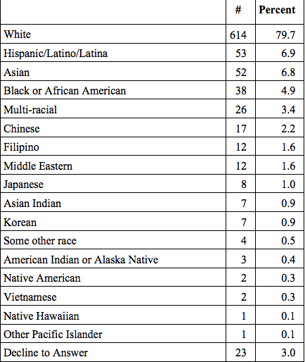
Ethnicity
n=747
Notes:
Ethnicity was a required question, but participants had the option to decline to answer. This is the breakdown of the responses received, and participants could choose more than one answer.
Ethnicity categories align with the U.S. Census Bureau’s survey.
We then decided to compare the large subgroups: Whites, Hispanic/Latino/Latina, Asian, and Black or African American. At times, we grouped together all Non-whites to compare Whites and Non-whites.

Slide 11
Specify major area of study
  Art (e.g. animation, graphic design, digital cinema, studio art, art history, etc.)
  Business (e.g. accounting, finance, marketing, management, etc.)
  Computing or related field (e.g. computer science, interactive media, human-computer interaction, information systems, information technology, etc.)
  Education
  Engineering
  Game design or development
  Humanities (e.g. art, history, philosophy, literature, languages, religion, etc.)
  Mathematics
  Natural or life sciences (e.g. astronomy, biology, chemistry, environmental sciences, physics, etc.)
  Nursing
  Performing arts (e.g. acting, costume design, music, theater, etc.)
  Social sciences (e.g. anthropology, economics, political science, psychology, sociology, etc.
  Other (please specify) ____________________
Notes:
We collected demographic data from all students on several campuses, including students who did not major in a computing field. We let respondents decide whether or not they were in a computing or related field.

Slide 12
In many schools, camps, and organizations, there are clubs and activities for learning about computers, such as programming, games, hardware, robotics, and more.
Some of these clubs and activities may meet only once, while others meet over the course of an entire year or longer. Some are activities within other clubs, such as Girl Scouts or Boy Scouts. Some meet as part of a class in school and others meet after school or during the summer or winter breaks, and even during special camps. Some use special software to introduce students to computer programming using tools like Scratch or Alice.
You may have participated in one or more of these activities in high school or even earlier. Think back for a moment and consider any of these types of activities that you may have participated in. This section asks you a few questions about these types of activities.
At some point in the past before starting college, did you participate in an activity or activities to learn about computers, like programming, game development, or robotics?
  Yes, as a required part of my classes in school or activities outside of school (clubs, scouts, churches, etc.)
  Yes, as a voluntary activity in conjunction with classes in school or activities outside of school (clubs, scouts, churches, etc.)
  No, I did not participate in such an activity
  I don’t recall
  Unsure (please comment) ____________________
Notes:
For the recall prompt, we reminded respondents of different activities that they may have participated in and when.
The first question that followed the prompt was asking them to select whether or not they participated in such an activity and whether or not it was required or voluntary.

Slide 13
Type of participation (n=565)
Notes:
Even in the data from this first response, you can start to see some differences between the subgroups.
For example, Asians were more likely to indicate that it was a required activity, and Blacks were more likely to indicate that it was a voluntary activity.
Hispanics/Latino/Latinas were more likely to indicate that they did not participate in an outreach activity.

Slide 14
Period of activity participation (n=520)
To the best of your recollection, when did you participate in this activity or activities (mark all that apply):
  While in high school
  While in middle or junior high school
  While in elementary school
  Others (please specify): ____________________
Notes:
We then asked respondents to recall when they participated in these activities.
Again, you can start to see the differences in the responses. Whites were more likely to have participated in junior high and elementary over Hispanic/Latino/Latina, and all non-whites in general.

Slide 15
Perceived effects of outreach activities on choice of major (n = 336)
Notes:
We asked about how respondents who participated in an outreach activity felt that this participation affected their decision to major (or not major) in a computing field.
Again, rather than a straight line across all subgroups, we say great variation.
Hispanic/Latino/Latinas were more likely to say that it did not affect their choice of major and more likely to say that they chose a major that DID NOT require them to study computing.
Asians and Blacks were more likely say that it affected their decision to choose to study computing.

Slide 16
Computing and participation activity
Chi-square test conducted to determine if there was a correlation between participation in an activity before college and whether or not the respondent was majoring in a computing related field.
Among whites, we found a weak relationship φ = -0.12, X(1) = 8.24, p = 0.004
For Asians, African Americans, Hispanics/Latino/Latina – no significant relationship found.
Notes:
So we dug a little bit deeper.
We ran a chi-square test to compare actual cs versus noncs majors against whether or not they participated in an outreach activity.
Among whites, we found a weak relationshi.
For Asians, African Americans, Hispanics/Latino/Latina – no significant relationship found.

Slide 17
Effect of participation on choice of computing courses (self-reported), non-majors only (n=263)
Notes:
Did participating in these outreach activities pique their interest in computing at all—even if they chose not to major in it?
For those who were not majoring in Computing but participated in outreach activities, we asked if this participation affected their decision to take a computing course in college.
Again, you see the variations in responses. We note that among whites, they did not feel that this affected their decision, while it did affect the other subgroups.
In fact, to a 30-50% response rate, Asians, Blacks, and Hispanics all felt that it did have a positive influence on them and they took a computing class. In their minds, the outreach had a positive affect.

Slide 18
Perceptions
Likert-like questions posed
  The majority of students participating in the activities were boys.
  I enjoyed many of the activities.
  I enjoyed learning about computers.
  I was interested in computers before I participated in the activities.
  I felt like I was a welcome part of the group participating in the activities.
Scale: 1 – strongly disagree through 5 – strongly agree
Notes:
As far as general perceptions about the acitivities, we posed five Likert-style questions and asked respondents to rate on a scale from 1 to 5 whether or not they agreed with the statements.

Slide 19
Perceptions
Found one significant difference in responses of those who chose not to major in a computing field.
  “I felt like I was a welcome part of the group participating in the activities”
  Whites (M=4.04, SD=0.95) were more likely to agree than non-whites (M=3.76, SD=1.14) (t(130.53) = -2.18, p = 0.046)
Compared the five major groups against each of the perspectives with an analysis of variance (ANOVA).
  Only one item found to have a significant difference was the first, “The majority of participants were boys.”, t(3)=2.85, p = 0.04.
    Blacks/ African Americans felt their groups were mainly boys (M=4.68, SD = 0.99)
    Asians felt that neither boys or girls dominated (M=3.68, SD = 1.19)
    For whites and Hispanics, the means were nearly similar, with M=4.14, SD=1.23 for whites and M=4.11, SD=1.05 for Hispanics.
Notes:
Found one significant difference in responses of those who chose not to major in a computing field.
“I felt like I was a welcome part of the group participating in the activities”
Whites were more likely to agree with this than non-whites.
We ran an ANOVA to compare the five major groups against each of the perspectives.
Only one item found to have a significant difference was the first, “The majority of participants were boys.”.
Blacks/ African Americans felt their groups were mainly boys
Asians felt that neither boys or girls dominated
For whites and Hispanics, the means were nearly similar, with more boys, but some girls as well.

Slide 20
Threats to Validity
Does not replace actual longitudinal study data
  Variety of variables may affect recollection
Sample size does not include those who did not go on to a 4-year college (plenty of tech schools, 2-year programs)
Did not collect type of outreach activity
Did not collect self-efficacy or knowledge gains
Did not evaluate experiences outside of activities (hobbies, cultural experiences, etc.)
  E.g., Whites and non-whites, due to the geek culture phenomenon being predominantly white and male, may recall these activities in different ways.
Notes:
This is the short-list of the threats to validity—I say short, because some of the participants attempted to recall activities from 10 years ago.
Does not replace actual longitudinal study data
Variety of variables may affect recollection
Sample size does not include those who did not go on to a 4-year college (plenty of tech schools, 2-year programs)
Did not collect type of outreach activity
Did not collect self-efficacy or knowledge gains
Did not evaluate experiences outside of activities (hobbies, cultural experiences, etc.)
E.g., Whites and non-whites, due to the geek culture phenomenon being predominantly white and male, may recall these activities in different ways.

Slide 21
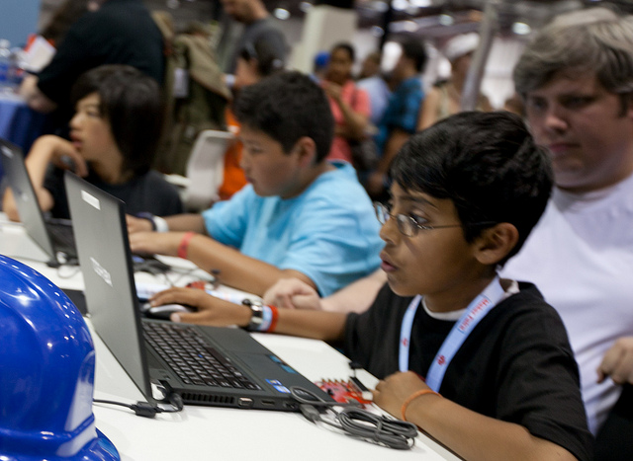
What do the results indicate?
With this long-term perspective, we find that there appears to be:
  Inequities in the availability of outreach activities across various ethnic groups (both required and voluntary).
  Inequities in the perceived impact on outreach activities across various ethnic groups.
    Recall that whites felt more welcome than non-whites
  Inequities in the actual impact on outreach activities across various ethnic groups.
These inequities appear to be long term, with long term effects.
Data provides another data point and source for informing change.
Notes:
So what do these results indicate? We believe that they indicate that there still remain inequities in the availability of outreach activities across the various groups.
Inequities in the availability of outreach activities across various ethnic groups (both required and voluntary).
Inequities in the perceived impact on outreach activities across various ethnic groups.
Recall that whites felt more welcome than non-whites
Inequities in the actual impact on outreach activities across various ethnic groups.
These inequities appear to be long term, with long term effects.
Data provides another data point and source for informing change.

Slide 22
What can we do next
We need longitudinal study data to evaluate whether outreach programs are effective (as a whole or individually) to determine which variables may or may not contribute to long-term success of these activities.
  Create and maintain a repository for longitudinal data
    Identify the particular demographic data that should be collected
    Invite program coordinators to collect the data
    Centralize the data over a period of x years
    Possibly provide the repository maintainers the ability to follow-up with the participants
    Allow data to be accessible by any researcher
  Provide additional support/resources for this type of data collection and repository at a state, national, and/or international level
Notes:
We need longitudinal study data to evaluate whether outreach programs are effective (as a whole or individually) to determine which variables may or may not contribute to long-term success of these activities.
Create and maintain a repository for longitudinal data
Identify the particular demographic data that should be collected
Invite program coordinators to collect the data
Centralize the data over a period of x years
Possibly provide the repository maintainers the ability to follow-up with the participants
Allow data to be accessible by any researcher
Provide additional support/resources for this type of data collection and repository at a state, national, and/or international level

Slide 23

Questions?
Adrienne Decker (adrienne.decker@rit.edu)
Monica McGill (mmcgill@bradley.edu)
Amber Settle (asettle@cdm.depaul.edu)
All photos from Creative Commons.
Notes:
Questions?

